Slide 1
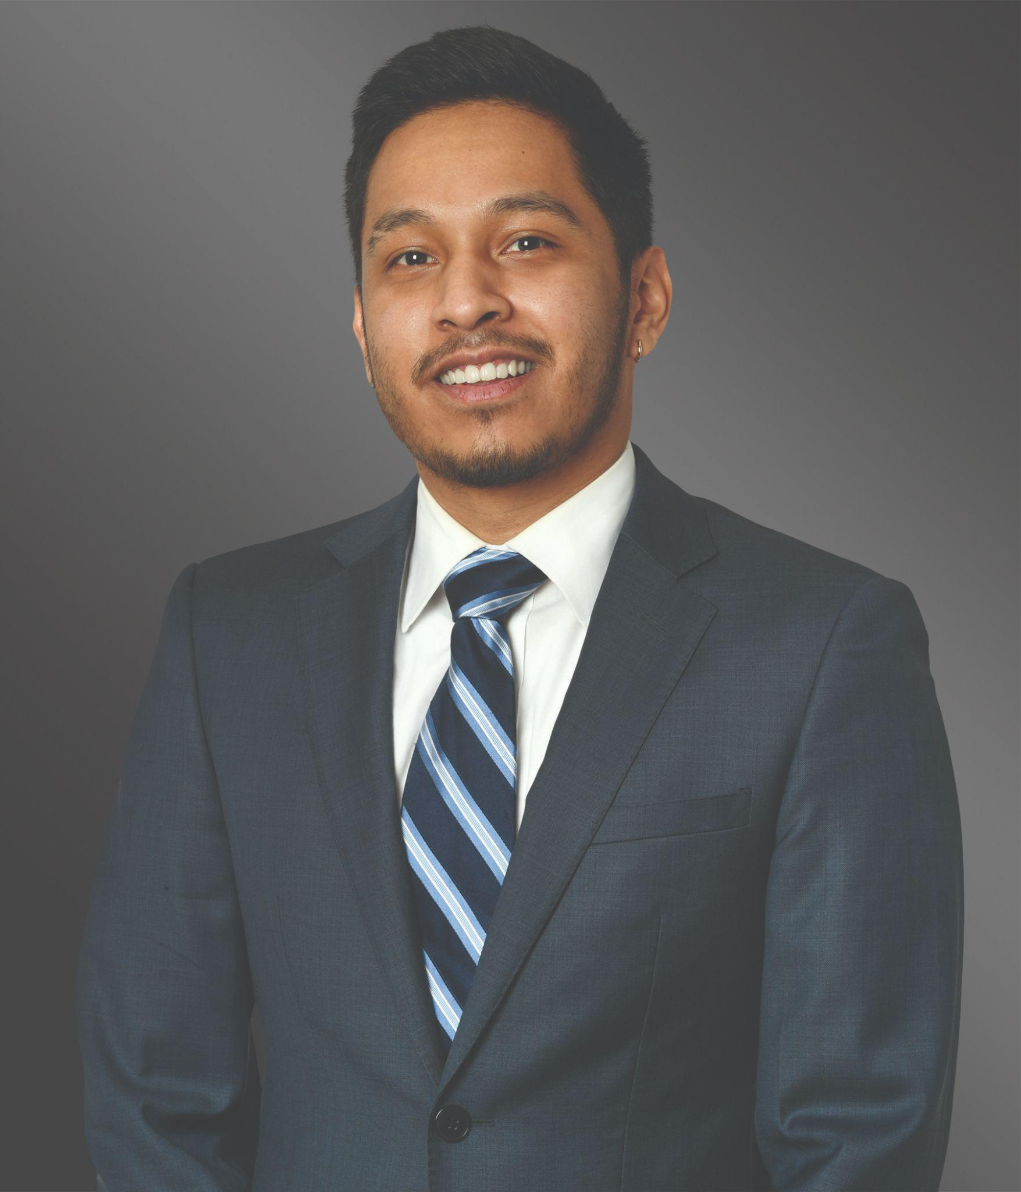
Profile Presentation
SENIOR INVESTOR RELATIONS ANALYST
Tractian
Alex O Longoria
Experienced Communications & Business Development Strategist

Slide 2
Alex Longoria
About me
Greetings,
My name is Alex, and I am a Communications & Business Development Strategist with experience in marketing, public relations, brand development, and business research. This experience is within a B2B business development or general awareness context in highly-regulated industries.
As a generalist, one of my special skills is the ability to wear many hats by immersing myself in different fields or contexts through constant research. My client service is focused on attentiveness, trust, and expectations management.
A few facts about me…
I listen to the FT daily briefing or the new ep. of OddLots on the way to the gym. | If I have the time, you’ll see me opt for public transit, so I can grab a few minutes with a history book.
My downtime is usually spent with my dog or out around town with friends. | I’m a huge cinephile.

Slide 3
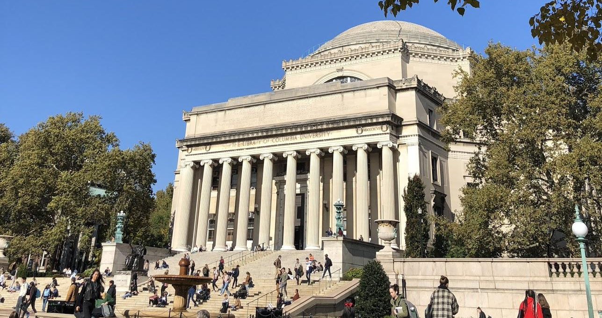
Alex Longoria
Education
With both a background in History and Mathematics, I’d say my education focused on writing and argument, as well as theories of change, development, relation, and systems.
Columbia University
B.A. in History & Minor in Mathematics
Highlights
Dean’s List
Kluge Scholar
Solid network of founders, consultants, finance professionals, and engineers
Courses in writing, economic history, financial modeling, multivariable calculus & graduate-level mathematics

Slide 4



Alex Longoria
Highlighted Skills
Software
Storytelling and writing
Client relationship management
Crisis communications
Financial analysis, competitive analysis, and executive reports
DEI and ESG reporting
C-suite collaboration
Content and data management for consistent and accurate reporting
Photoshop
Illustrator
Excel
PowerPoint
300+
Native
GitHub
Press releases, reports, and presentation decks
Spanish speaker

Slide 5
Alex Longoria
Experience
A redistillation of my work experience, tailored for this role…
Independent Contractor
Practice Development Assistant
2025 - Present
2019 - 2020
Selling myself!
Communications and brand strategies.
Coaching
Proposal and pitch writing and strategy
Press releases on major asset transactions
Content repository maintenance
Relationship management with industry organizations
DEI Marketing & BD COordinator
Legal Assistant
2020 - 2025
2017 - 2018
Web content, press release, and marketing materials production
Data and demographic disclosure to clients for supplier diversity requirements
Client communications and project collaboration
Business analysis
Cultural competency
Deadline and communications calendar management
Spanish communications regarding legal matters

Slide 6

Alex Longoria
Tractian pushes the limits of our industrial sector in a very literal sense.Our current moment is largely a race to create productive value from AI–largely through content–that can demonstrate real returns on trillions of investment dollars. I would bet Tractian is a winner in this race by providing scalable products and services that tangibly solve industrial inefficiencies.
Why I’m rooting for ?
SERIES C FUNDING
COMPETITIVE ADVANTAGE
Tractian’s consistent VC funding is validation of serious future returns on investment from accredited investors, not a speculation trend. Moreover, backing from Sapphire, General Catalyst, etc. suggests a promising public exit.
When compared to competitors, Tractian is able to flex its richness in features and hours of cognitive labor saved. Visible and measurable value provides plenty of raw meat for current and potential investors.
TECHNOLOGY BUNDLE
Customer Testimonials
Bundling patented sensors and continuously trained AI-based SaaS creates a strong market position based on Tractian’s hardware market niche, expected software improvement, and an open-ended demand for services.
Tractian has great customer testimonials on its own website and on other platforms and tech media outlets.

Slide 7
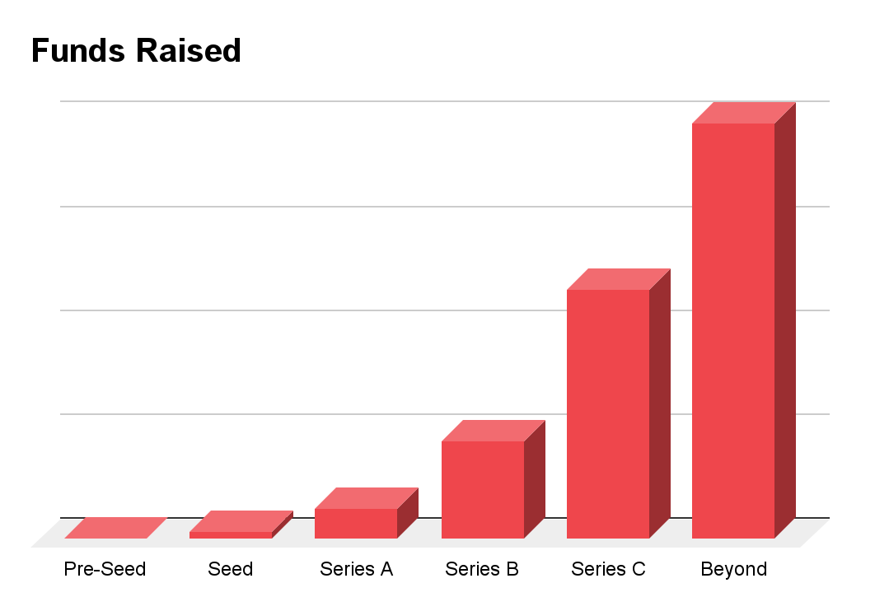
Alex Longoria
Driving forward
Why not hire a professional with the right credentials and experience?
Tractian needs a Senior Investor Relations Analyst that can create and maintain the most reliable and effective communication assets, while also providing consistent, first-in-class client service. A successful IR team can help sustain and cultivate perceived value.
Quality stakeholder interface
Quick and responsive
Translates sensitive data for general audiences
Designs appealing decks and one-pagers
Systemic thinker
Cross-collaborates across teams and with senior leaders
Exceeds operational needs and requirements to deliver qualitative development, visible in quantitative terms

Slide 8
Alex Longoria
What you can expect from me.
Understand Tractian’s story and its direction.
Know the numbers: horizontal, vertical, and comparative analyses.
Provide excellent and welcoming client service.
Maintain a tight communications calendar.
Provide responsive and transparent communications to stakeholders that are growth and asset-forward.
Manage a repository of commonly reported information and written content.
Provide a throughline over time to support the growth of Tractian’s investor relations functions as it grows and possibly prepares for an IPO.
Consistent and high-quality communications. Identifying and confidently presenting value.
My immediate goal is to provide a seamless transition and integration onto Tractian’s Finance Team to free valuable time and resources by getting a running start. My prior experience positions me well to shorten any learning curves.
Creating trust and good relationships with leaders, all teams that are attached to necessary information channels, and investors is also a priority. Together, we can achieve my ultimate goal of sustaining and creating value for Tractian.

Slide 9

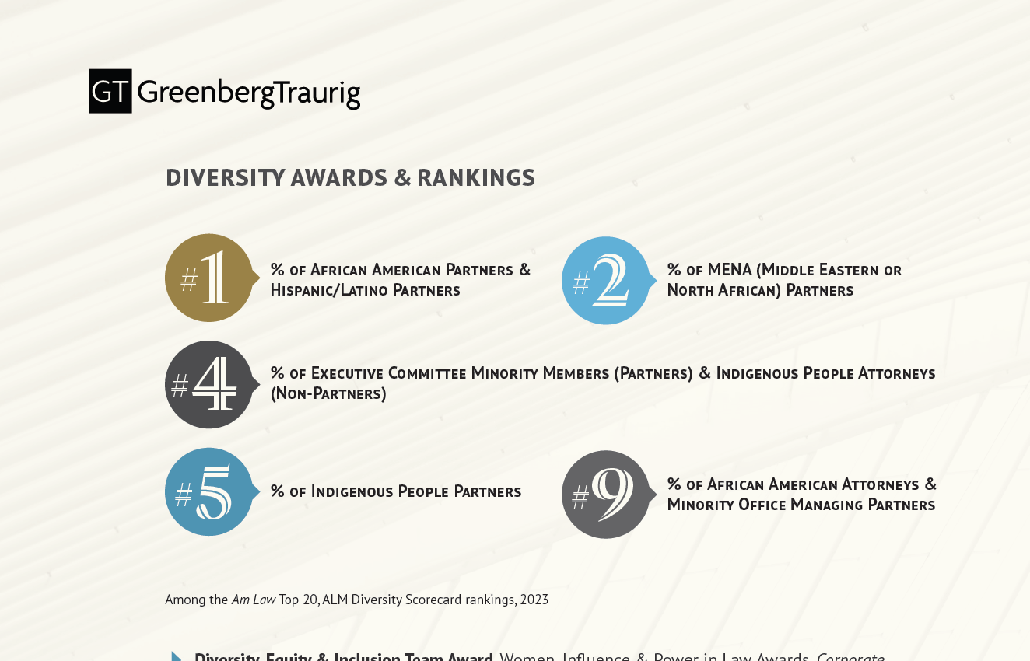
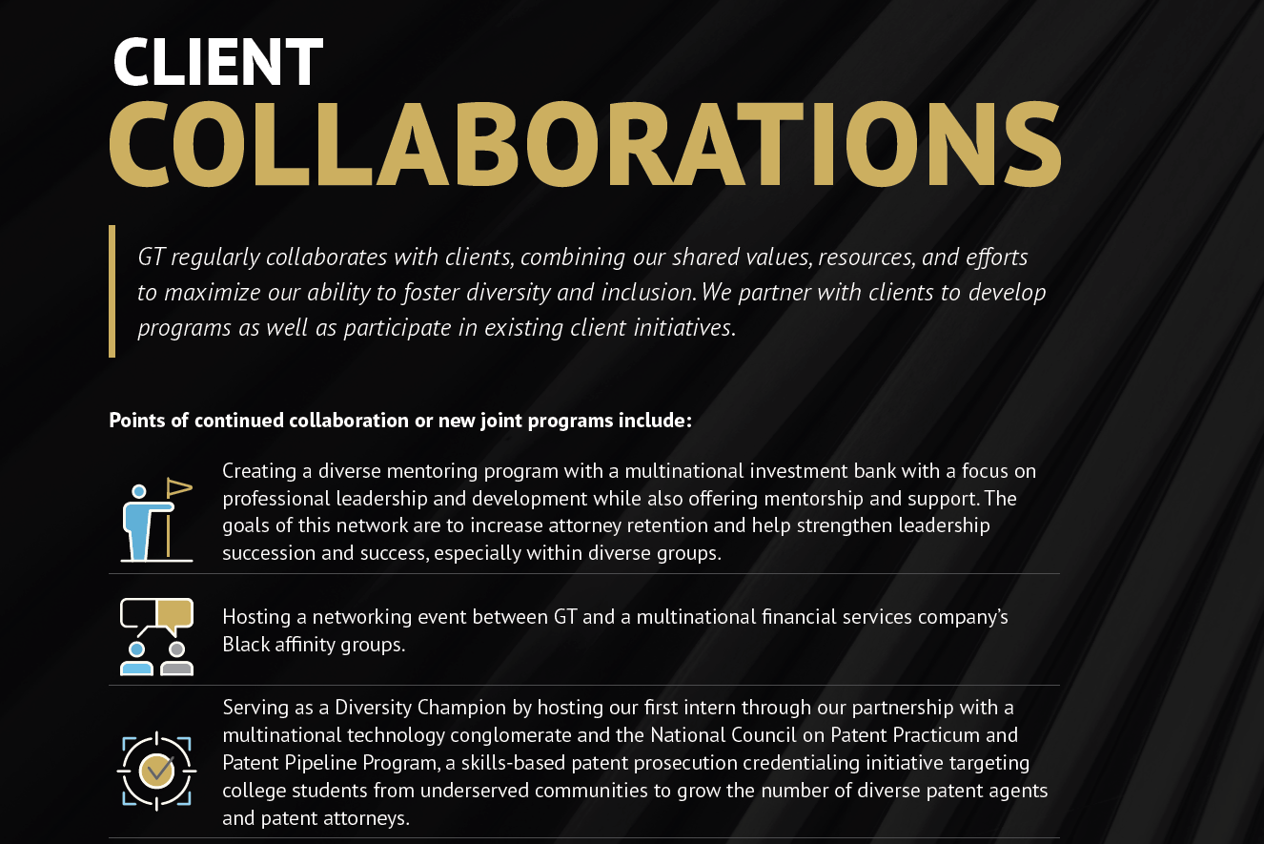
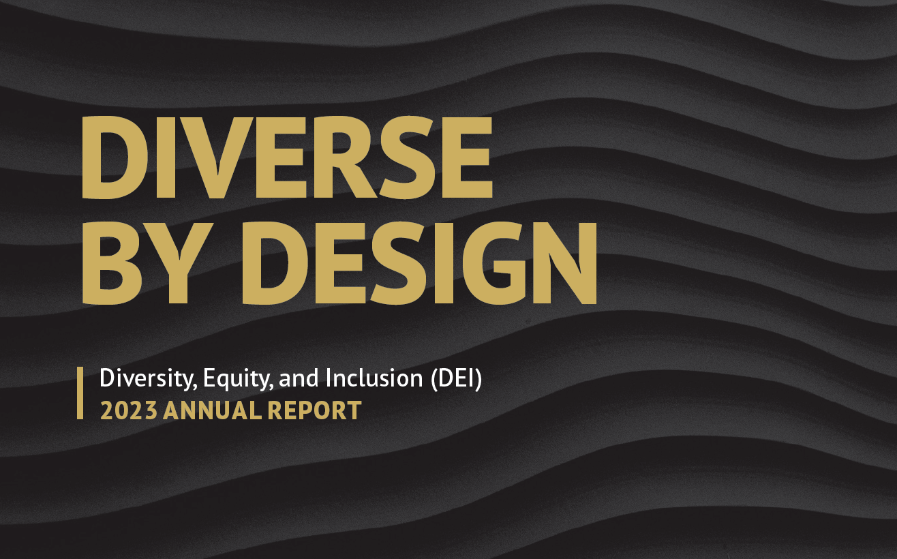
Alex Longoria
Take a closer look at some of my shareable work from other roles on my GitHub!
Sample Work
This design and writing project was launched by me when my Chief Diversity Officer and Co-President wanted an updated newsletter that we could share sensitive but important initiatives with internal stakeholders and external audiences. This document served as the foundation for all presentations, one-pagers, and web content.

Slide 10
Alex Longoria
Contact
Thank you for your time and consideration. Please feel free to contact me if you have any additional questions. I look forward to hearing from you!
AlexOLongoria@gmail.com
+1 678 908 6841
Atlanta, GA

